Slide 1
NODE.JS
(The Backend Of MERN Stack)
Lecture 11

Slide 2
Today’s Agenda
Accepting user input
Introduction to Command Line Arguments
Using argv
Introduction to prompt-sync
Using prompt-sync for user input

Slide 3
Accepting user input
Node.js provides us many ways to accept user input from console .
The two very popular approaches are:
Command line arguments
Using prompt-sync module

Slide 4
Command line arguments
Command-line arguments (CLI) are strings of text used to pass additional information to a Node.js script when it is executed through console window or terminal .
Syntax:
node <script_name> <arg1> <arg2> . . . <argn>

Slide 5
Retrieving arguments
The simplest way of retrieving arguments in Node.js is via the process.argv array.
process is a global object that we can use without importing any additional libraries .
We simply need to pass arguments to a Node.js application, and these arguments can be accessed within the application via the process.argv array.

Slide 6
What argv holds ?
The argv array holds the following values as string:
The first element of the process.argv array will always be a file system path pointing to the node executable.
The second element is the name of the JavaScript file that is being executed.
And the third element is the first argument that was actually passed by the user.

Slide 7
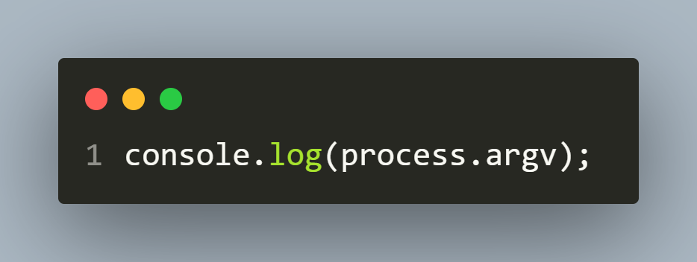
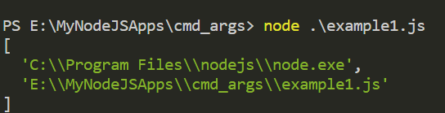
Example 1
example1.js
output

Slide 8
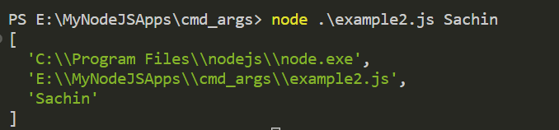
Example 2
example2.js
output

Slide 9
Exercise 26
WAS to accept some names through command line arguments and display them prefixed with a Good Evening message.
Make sure that if the user doesn’t pass any arguments then the code displays the message Good Evening guest

Slide 10
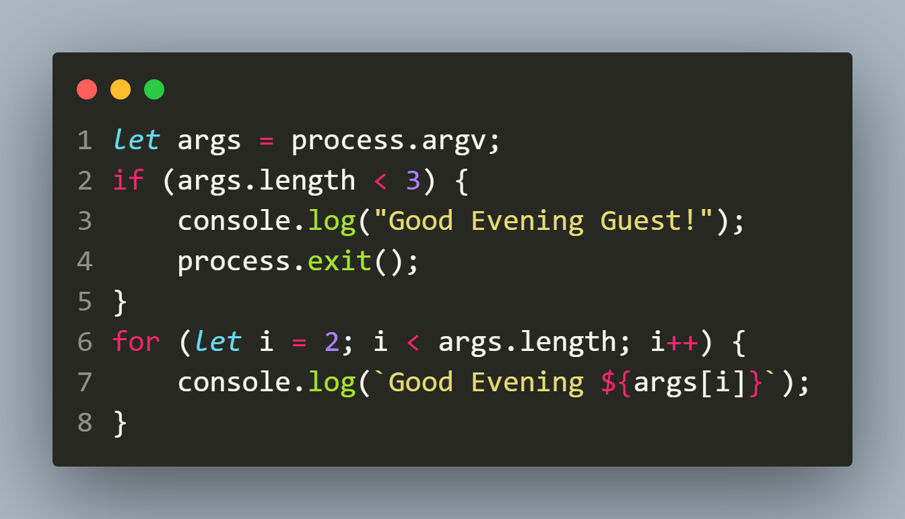
Solution

Slide 11
Exercise 27
WAS to accept some integers through command line arguments and display their sum and average.
Make sure that if the user passes less than 2 arguments then the code displays the message Please pass atleast 2 nos

Slide 12
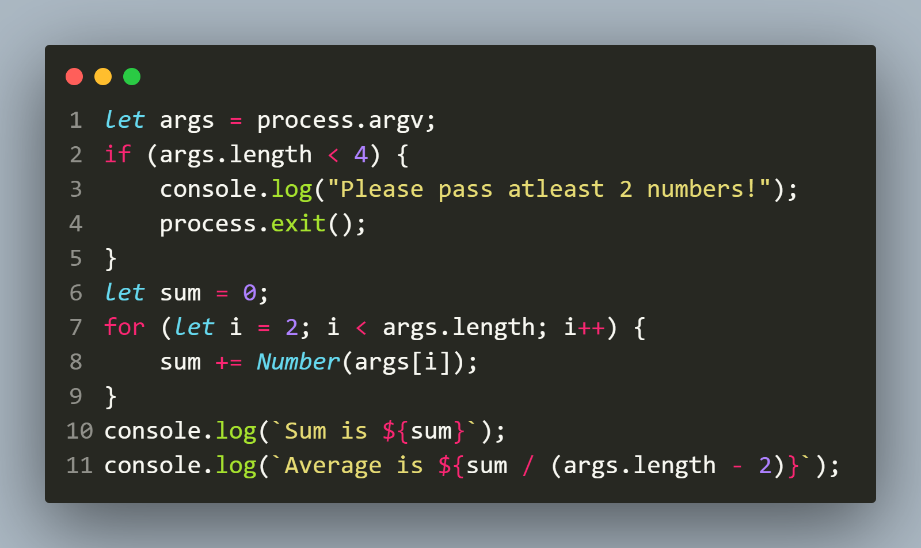
Solution

Slide 13
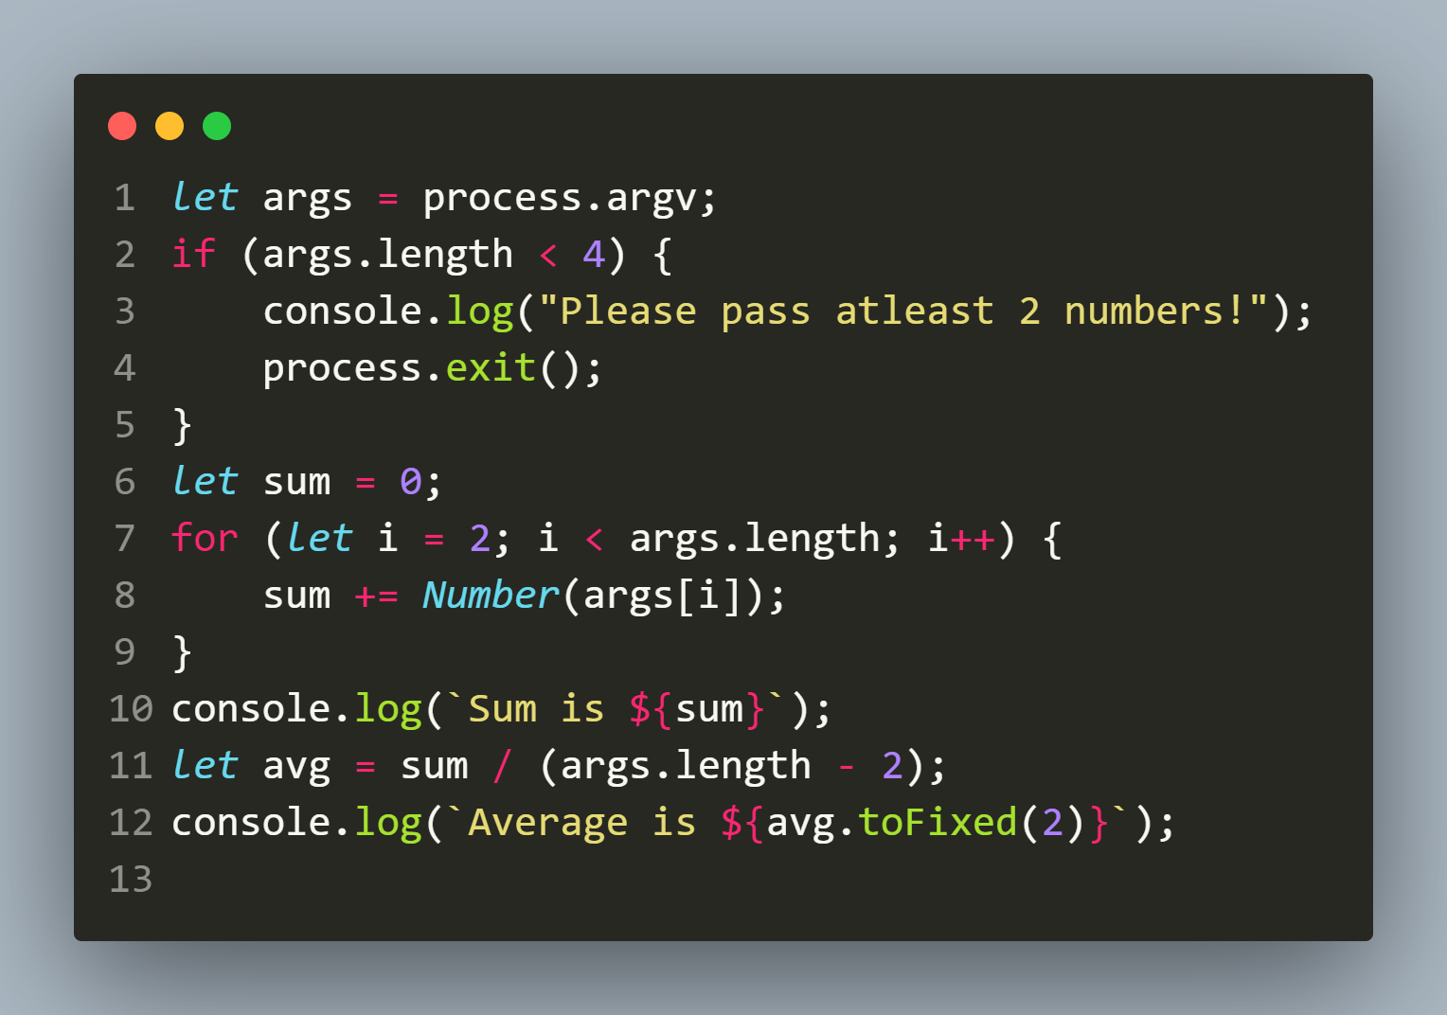
Solution 2

Slide 14
Exercise 28
WAS to accept some integers through command line arguments and display their sum and average in green colour
Make sure that if the user passes less than 2 arguments then the code displays the message Please pass atleast 2 nos in blue colour
Also make sure that if the user passes any non-integer value then the code displays the message Please pass integers only in red colour.

Slide 15
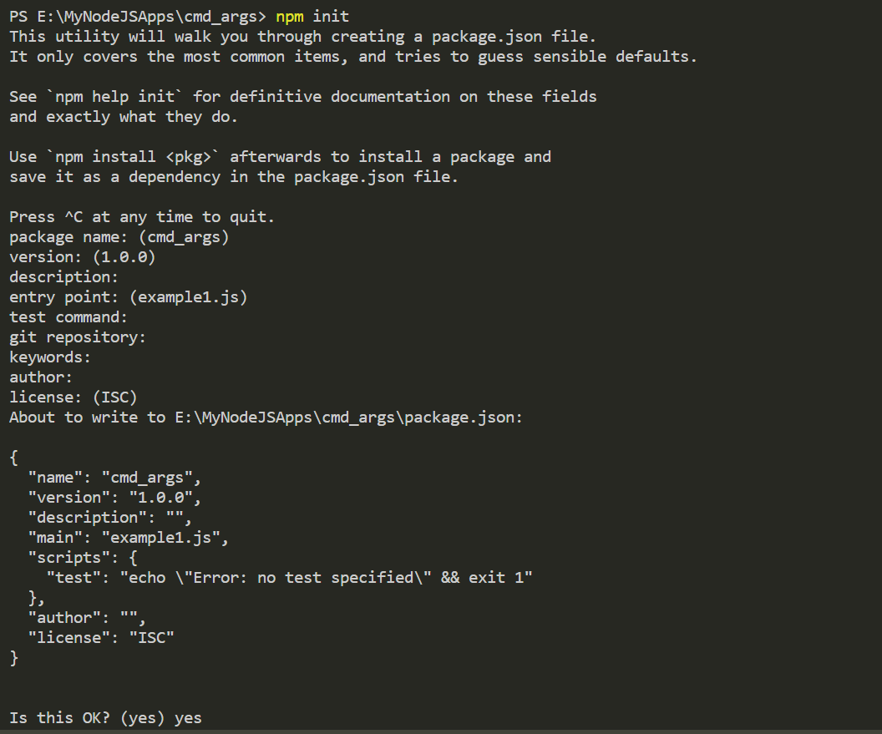
Solution
Run the npm init command

Slide 16
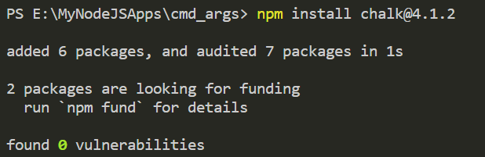
Solution
Run the npm install chalk@4.1.2. command

Slide 17
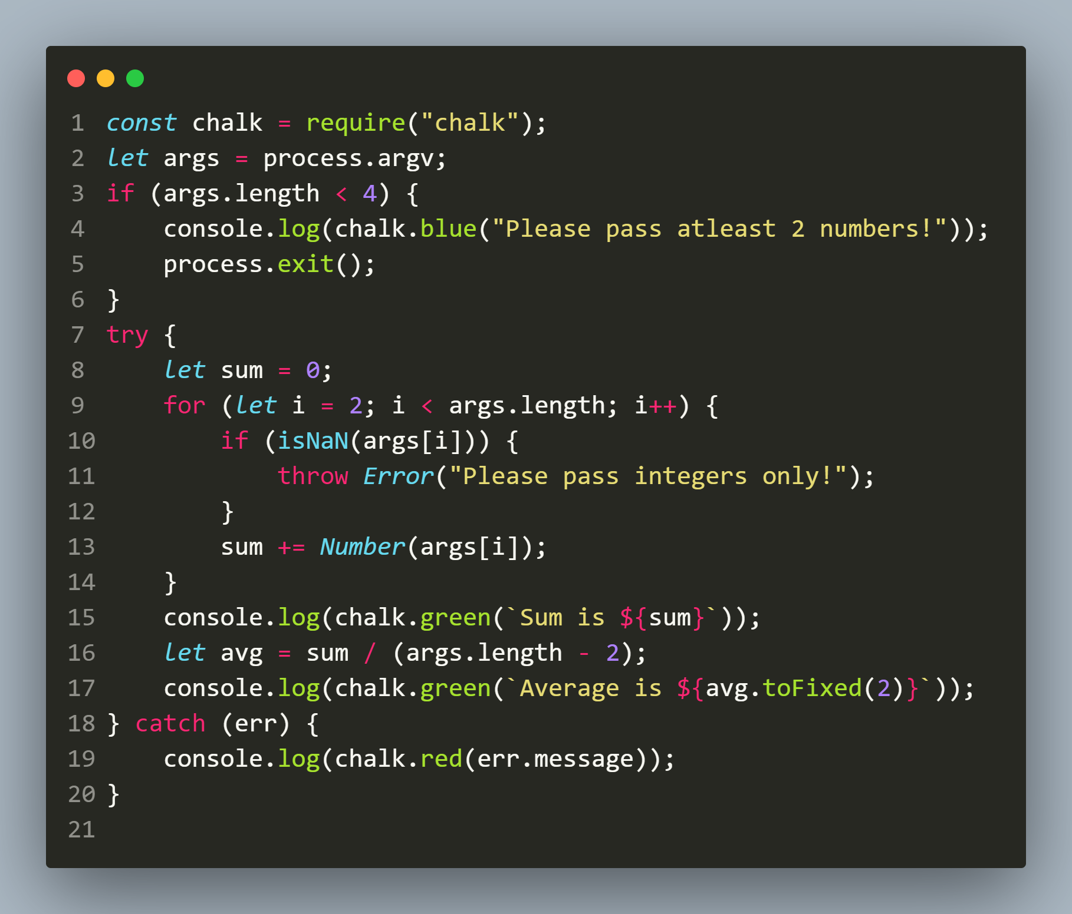
Solution

Slide 18
Introduction to prompt-sync
The prompt-sync module is a 3rd party module and it provides the simplest way to take inputs from the user in a Node.js command line application.
But since it is not a core Node.js module , so we first need to install it as follows:
npm install prompt-sync

Slide 19

Using prompt-sync
The first step in using prompt-sync module is load and run its setup function as shown below:
Make sure to add a pair of brackets after importing the module, which causes the module to run a setup function automatically.

Slide 20
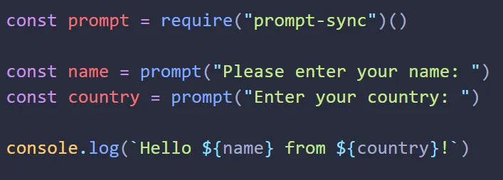
Using prompt-sync
We can now declare variables to receive user input easily, using the template :
const variable = prompt(message);

Slide 21
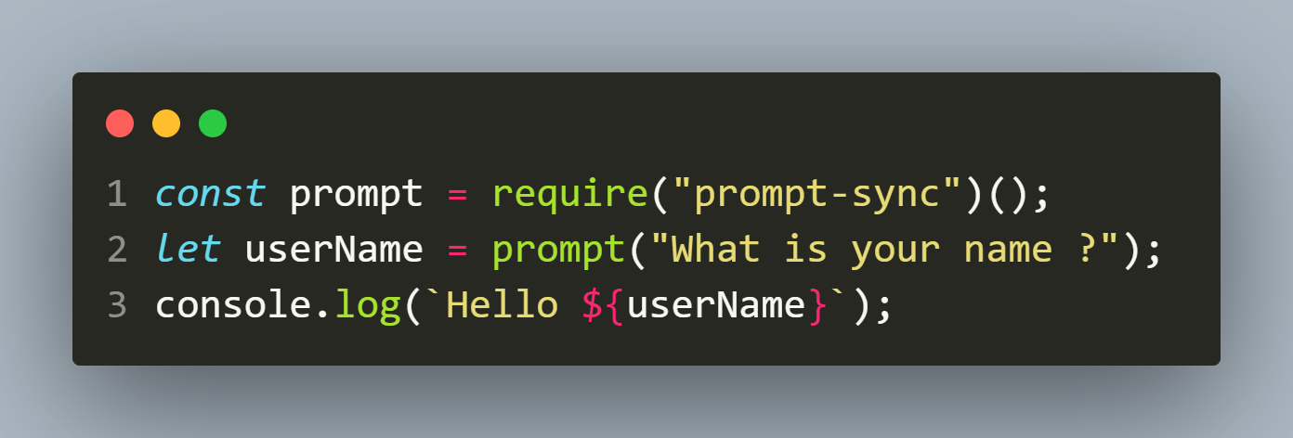
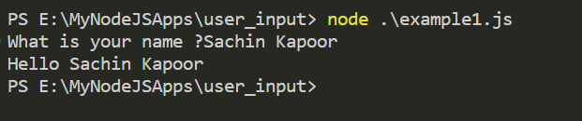
Example 1
example1.js
output

Slide 22
Exercise 29
WAS to accept 2 integers from the user and display their sum in green colour.
Make sure that if the user passes any non-integer value then the code displays the message Please pass integers only in red colour.

Slide 23
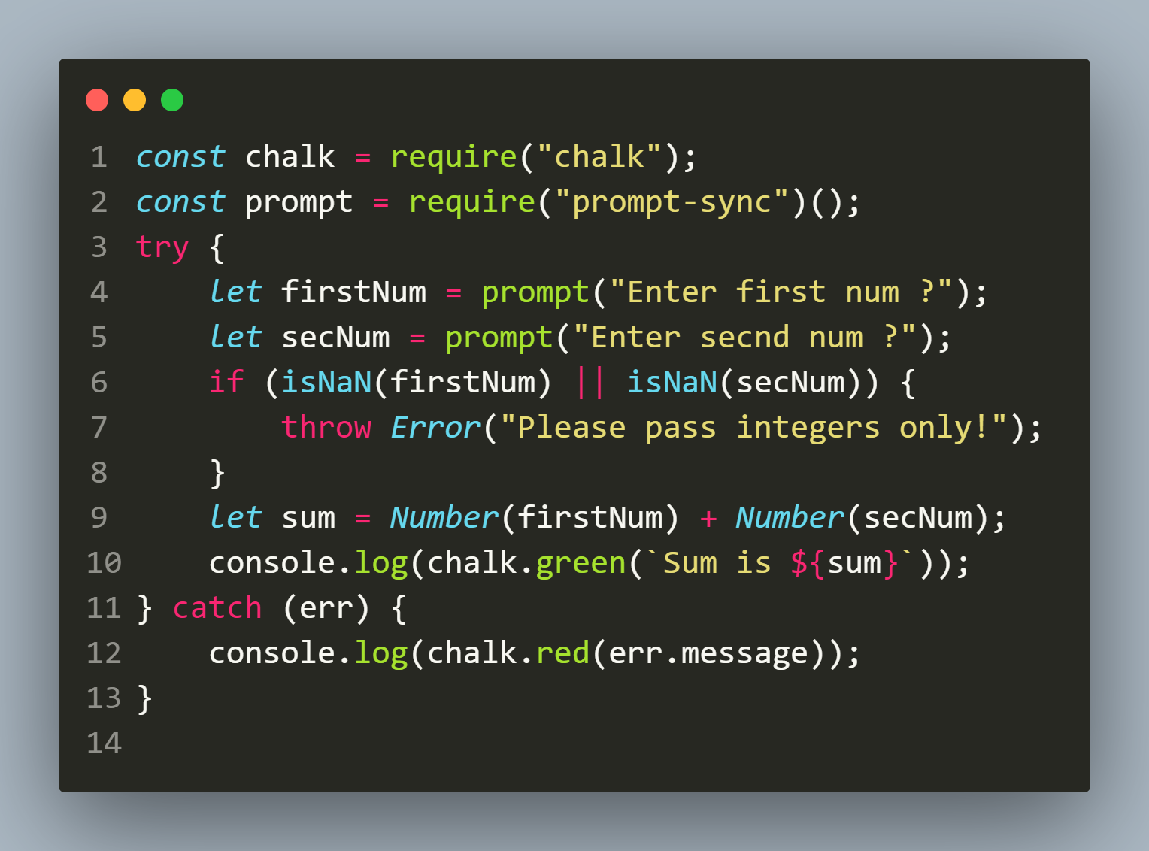
Solution

Slide 24
Letting the user exit
By default, most terminal programs will exit with Ctrl + C .
This is because it sends a SIGINT, or “signal interrupt” message indicating that a user wants to exit the program.

Slide 25
Letting the user exit
With prompt-sync, by default the code continues even if the user presses CTRL+C

Slide 26

demo
The Code
The Output

Slide 27
How to solve this ?
To change this behavior and make sure that our users can exit at will, we need to add a configuration object while calling the prompt-sync function.
This object is created with just one property called sigint with the value true .

Slide 28
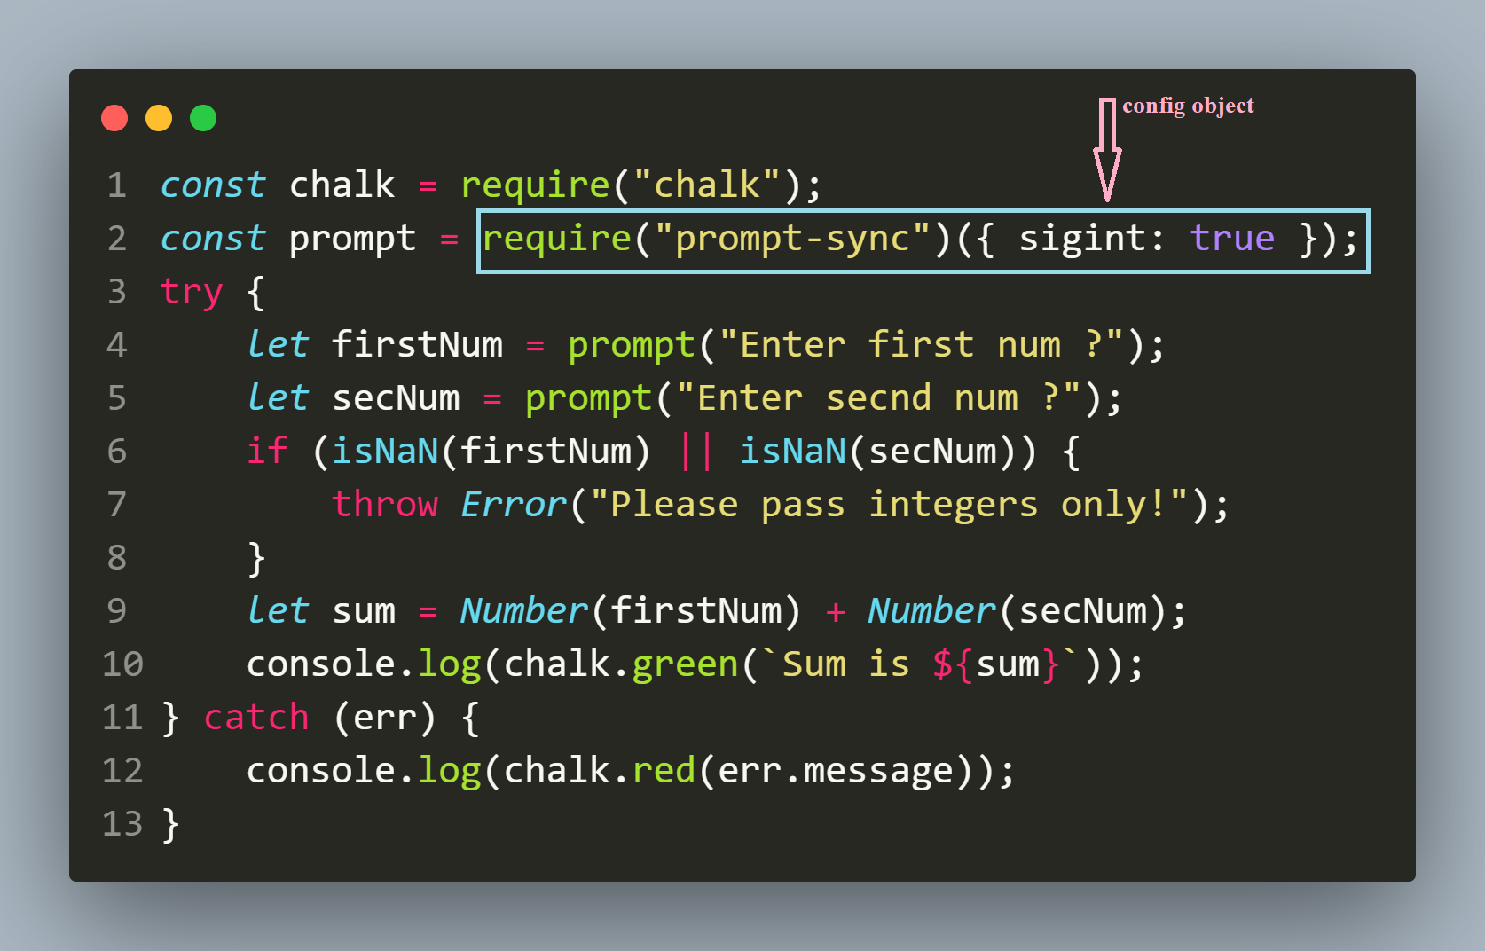

Letting user exit
The Code
The Output

